Slide 1
Introduction to MySQL RENAME USER statement
The RENAME USER statement renames one or more existing accounts. Here is the basic syntax of the RENAME USER statement:
RENAME USER old_user1
TO new_user;
In this syntax:
First, specify the name of the existing user that you want to rename.
Second, specify the new user name after the TO keyword. The new name must not exist or you will get an error.

Slide 2
If you want to rename multiple user accounts at once, you use the following syntax:
RENAME USER
old_user1 TO new_user1,
old_user2 TO new_user2,
...
The RENAME USER transfers all privileges of the old users to the new users. However, it does not drop or invalidate database objects that are dependent on old users.
For example, assuming that you have a stored procedure whose the DEFINER attribute specifies the old user. And this stored procedure executes in the definer security context. If you rename the old user, then you will get an error if you execute the stored procedure.

Slide 3
MySQL RENAME USER examples
Let’s take some examples of using the MySQL RENAME USER statement.
A) Using MySQL RENAME USER to rename one user example
First, create a new user called john@localhost:
CREATE USER john@localhost
IDENTIFIED BY 'Super!pass1';
Second, use the RENAME USER to rename user john@localhost:
RENAME USER john@localhost
TO doe@localhost;
Third, query data from the mysql.user to verify the rename:
SELECT host, user
FROM mysql.user
WHERE user = 'doe' and host = 'localhost';

Slide 4
B) Using MySQL RENAME USER to rename multiple user accounts example
First, create two user accounts jill@localhost and hill@localhost
CREATE USER jill@localhost
IDENTIFIED BY 'Super!pass1';
CREATE USER hill@localhost
IDENTIFIED BY 'Super!pass1';

Slide 5

Second, use the RENAME USER statement to rename these two users:
RENAME USER
jill@localhost TO jin@localhost,
hill@localhost TO hank@localhost;
Third, query data from the mysql.user to verify the rename:
SELECT host, user
FROM mysql.user
WHERE user IN ('jin','hank');

Slide 6
C) Using MySQL RENAME USER to rename a user account associated with a stored procedure
First, create a new user account called fx:
CREATE USER fx
IDENTIFIED BY 'Super!pass2';
Second, grant all privileges to fx:
GRANT ALL ON *.*
TO fx;

Slide 7
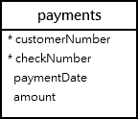
Third, login as fx and create a procedure that returns all rows from the payments table in the sample database:

Slide 8
DELIMITER $$
CREATE DEFINER=fx PROCEDURE GetPayments()
SQL SECURITY DEFINER
BEGIN
SELECT * FROM payments;
END$$
DELIMITER ;
The definer of the procedure is fx and SQL SECURITY specifies that the procedure will execute with the privileges of the definer.
Fourth, login as root and call the GetPayments() procedure:

Slide 9
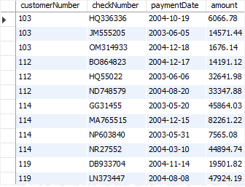
CALL GetPayments();

Slide 10
Fifth, rename the user account fx to fc:
RENAME USER fx TO fc;
Sixth, call the GetPayments() procedure again:
CALL GetPayments();
MySQL issued the following message:
Error Code: 1449. The user specified as a definer ('fx'@'%') does not exist
To fix this issue, you need to manually change the definer in the stored procedure GetPayments() and save it.

Slide 11
Thank You
Please Subscribe My Channel
https://www.youtube.com/channel/UCYW3PWPOPn3qgxxjhUbXXXg?view_as=subscriber

